Slide 1
4.5 Class vs Instance variables and methods
ITP3914 – Programming
Part 4 – Programming with Objects and Classes

Slide 2
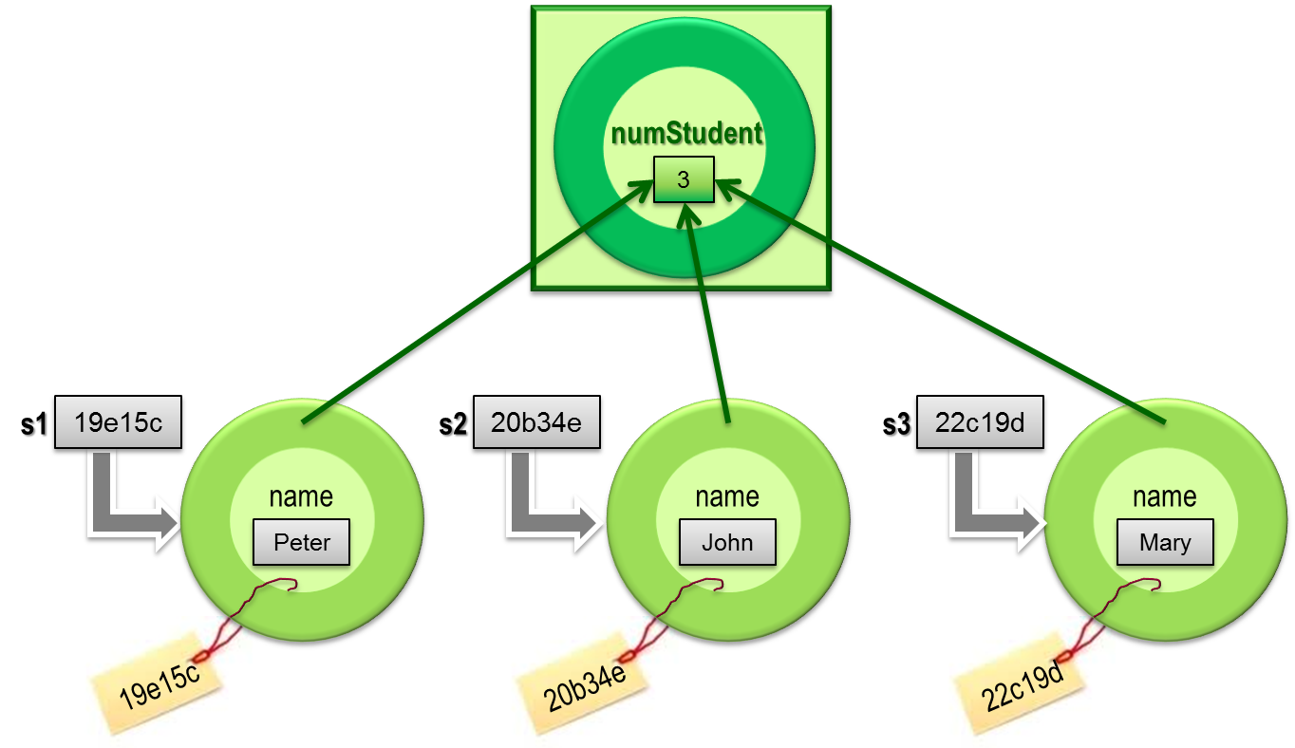
What is a static variable?
Normally, each object instance has its own copy of instance variables.
With a static variable, only one copy of the variable exists and is shared by all object instances of the class.
public class HdSeStudent {
private static int numStudent = 0;
private String name;
…
}

Slide 3
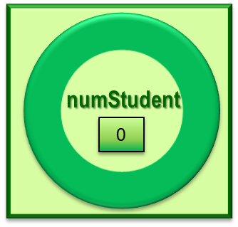
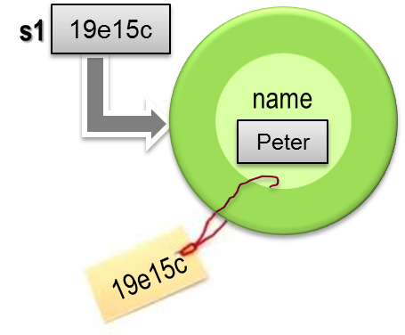
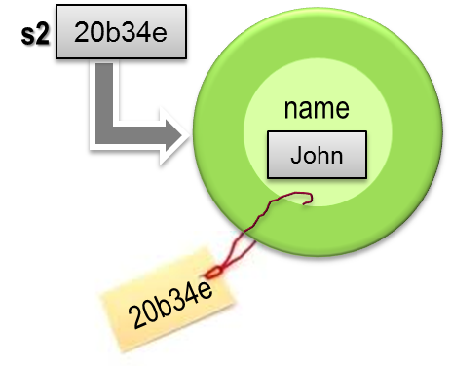

public class HdSeStudent {
private static int numStudent = 0;
private String name;
public HdSeStudent() {
this.name = "Ghost";
numStudent++;
}
public HdSeStudent(String name) {
this.name = name;
numStudent++;
}
public String getName() {
return name;
}
public int getNumStudent() {
return numStudent;
}
1
2
3
public static void main(String [ ] args) {
HdSeStudent s1 = new HdSeStudent("Peter");
System.out.println("Num of Student = " + s1.getNumStudent());
HdSeStudent s2 = new HdSeStudent("John");
System.out.println("Num of Student = " + s2.getNumStudent());
HdSeStudent s3 = new HdSeStudent("Mary");
System.out.println("Num of Student = " + s3.getNumStudent());
}
}
C:\> java HdSeStudent
Num of Student = 1
Num of Student = 2
Num of Student = 3

Slide 4
static methods
Recall that a static variable belongs to the whole class, not a particular object instance.
Thus, a static variable exists even if no object instance of the class has been created yet.
Problem – How can we access a static variable before an object instantiation of that class?
Solution – static methods
Use the keyword static to define a static method:
public static int getNumStudent() { … }
You can call a static method via its class name:
HdSeStudent.getNumStudent();

Slide 5
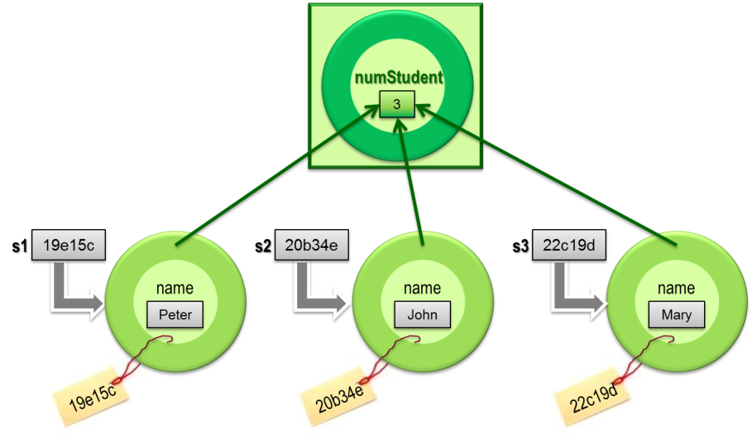
public class HdSeStudent 2 {
private static int numStudent = 0;
private String name;
public HdSeStudent() {
this.name = "Ghost";
numStudent++;
}
public HdSeStudent(String name) {
this.name = name;
numStudent++;
}
public String getName() {
return name;
}
public static int getNumStudent() {
return numStudent;
}
C:\> java HdSeStudent2
Num of Student = 0
------------------
Num of Student = 1
Num of Student = 2
Num of Student = 3
------------------
Num of Student = 3
public static void main(String [ ] args) {
System.out.println("Num of Student = " +
HdSeStudent2.getNumStudent() );
System.out.println("------------------");
HdSeStudent2 s1 = new HdSeStudent2("Peter");
System.out.println("Num of Student = " + s1.getNumStudent());
HdSeStudent2 s2 = new HdSeStudent2("John");
System.out.println("Num of Student = " + s2.getNumStudent());
HdSeStudent2 s3 = new HdSeStudent2("Mary");
System.out.println("Num of Student = " + s3.getNumStudent());
System.out.println("------------------");
System.out.println("Num of Student = " +
HdSeStudent2.getNumStudent() );
}
}

Slide 6
Some more static examples
In the Math class,
public static final double PI = 3.14159;
Can you tell why PI is defined as so?
Example use: area = radius*radius*Math.PI;
Again in the Math class,
public static double sqrt(double a) { … }
public static double sin(double a) { … }
Example use: System.out.print(Math.sqrt(100.5));
In a Java application:
public static void main(…) { … }
Can you tell why main() is defined as static?

Slide 7

END.

